Slide 1

SMART INDIA HACKATHON 2026
TITLE PAGE
Problem Statement ID – 26208
Problem Statement Title- Student Innovation
Theme- Heritage & Culture
PS Category- Software
Team Name – Prisha_ki_sena
Team ID– 60

Slide 2
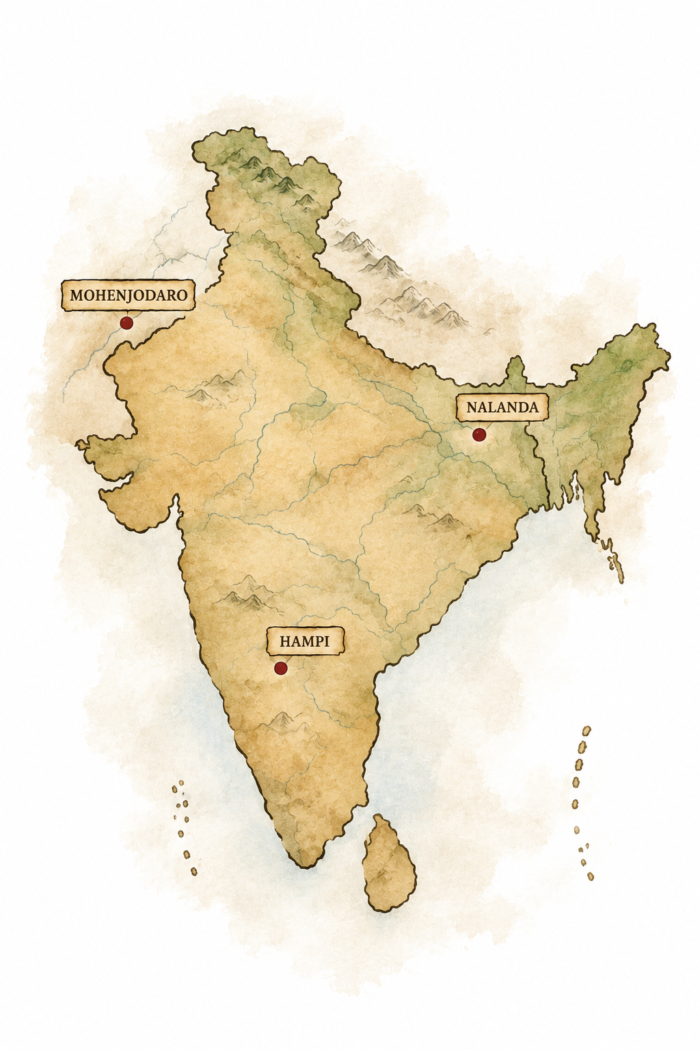
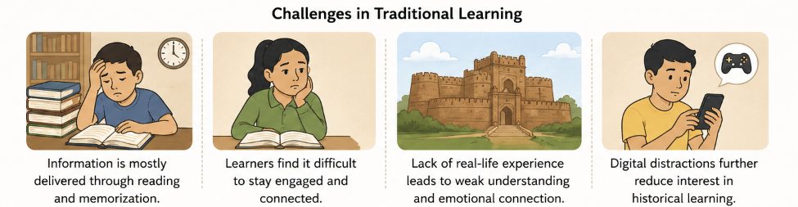

IDEA TITLE
Prisha_ki_sena
Bharat has a rich and diverse historical and cultural heritage. However, the way history is taught today is mostly passive, text-heavy and memorization-based.This makes learning less engaging and creates a disconnect between young learners and their roots.
There is a need for interactive, technology-driven solution that turns historical knowledge into an engaging experience, allowing learners to explore, interact and discover India’s heritage in an active and immersive way.

Slide 3
PROPOSED SOLUTION
Prisha_ki_sena
DHAROHAR
DHAROHAR is an interactive historical game that converts Bharat’s history and cultural heritage into playable stories. Players explore historical worlds, interact with characters, complete culturally inspired quests, solve puzzles, and discover authentic historical knowledge through gameplay.
Innovation & Uniqueness
How it addresses the problem
History as gameplay
Read → Explore
II. Quest based learning
II. Memorize -> Discover
PASSIVE LEARNING → ACTIVE EXPERIENCE
III. Authenticity first
III. Static facts -> Interactive
IV. Textbook Stories-> Playable experiences
IV. Modular & Scalable

Slide 4
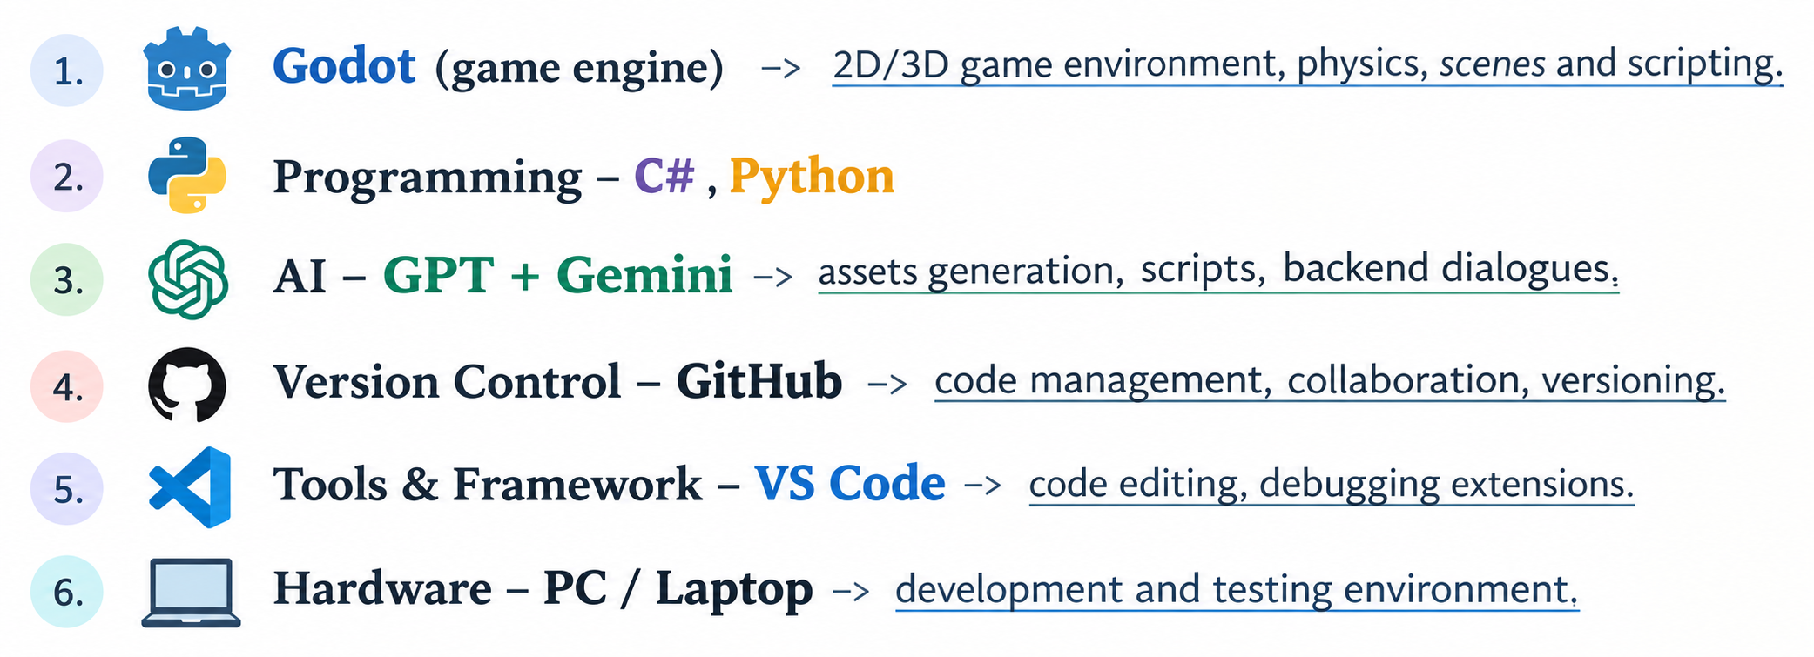
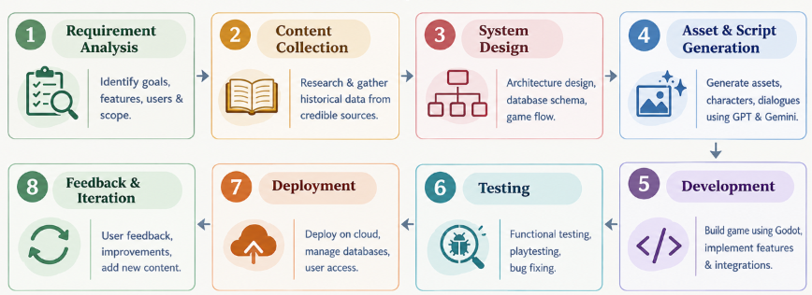
TECHNICAL APPROACH
Prisha_ki_sena
DHAROHAR is developing as a standalone game, and will be packaged as an executable (.exe) for direct installation and offline gameplay.
WHY THIS TECH STACK ?
Performance
Lightweight technologies for smooth gameplay and efficient execution.
Scalability
Modular architecture allows new eras, stories, assets and mechanics to be added easily.
AI-Assisted Creation
GPT + Gemini support faster generation of assets, scripts, dialogues and content assistance.
GAME FLOW
Version Control
GitHub enables collaborative development, code management and version tracking.

Slide 5
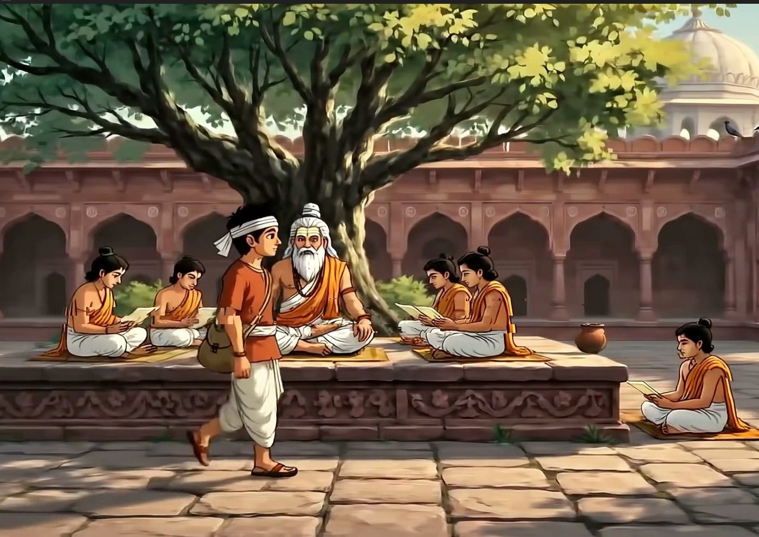
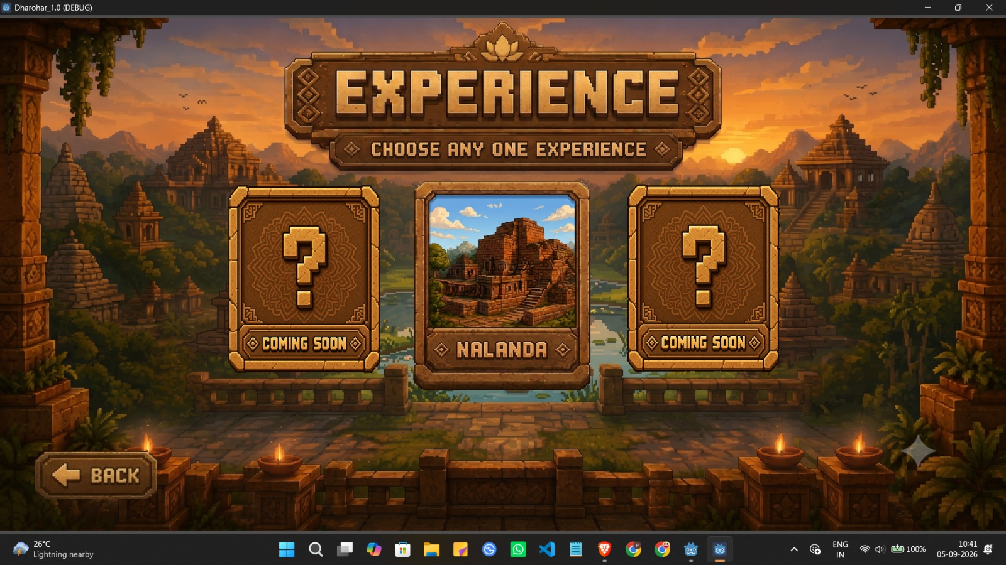
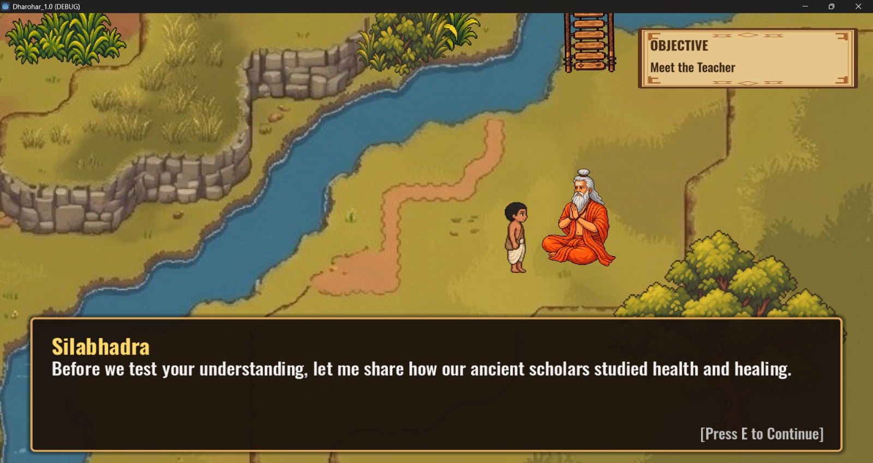
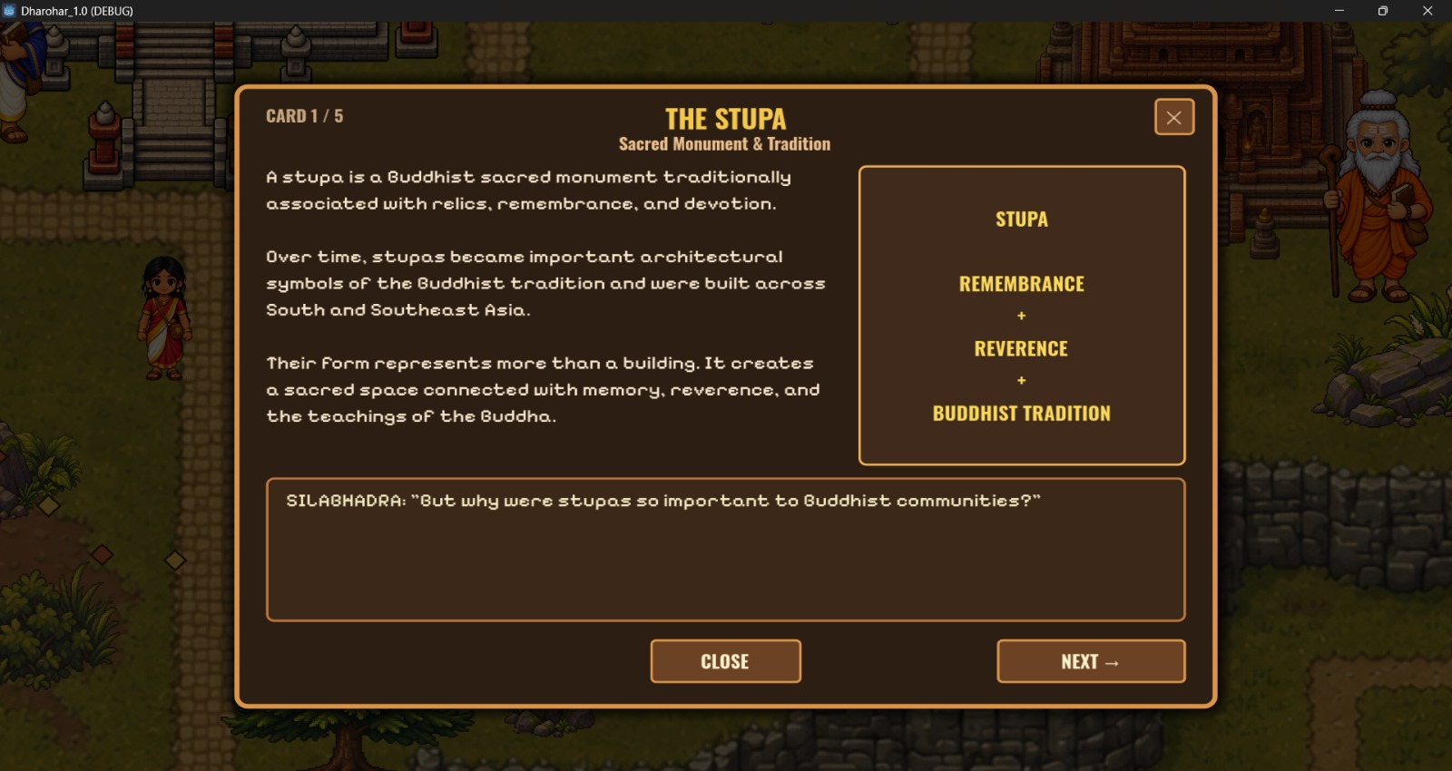
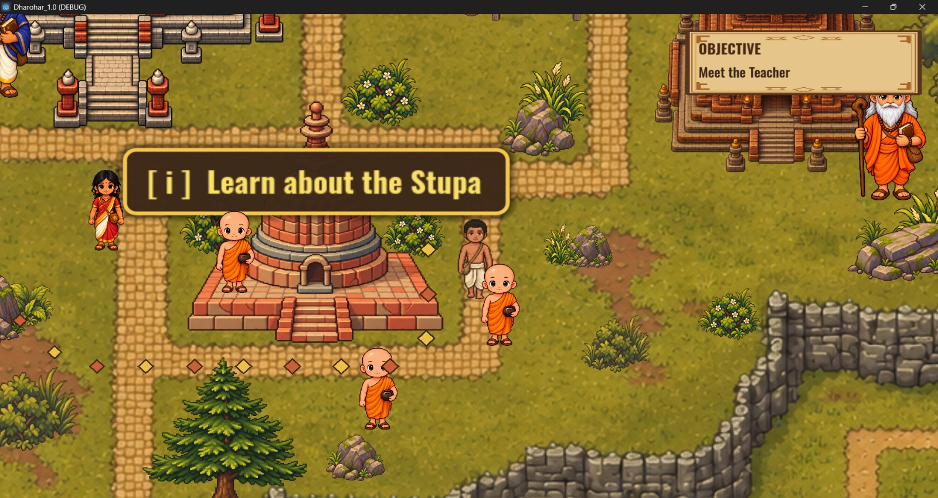
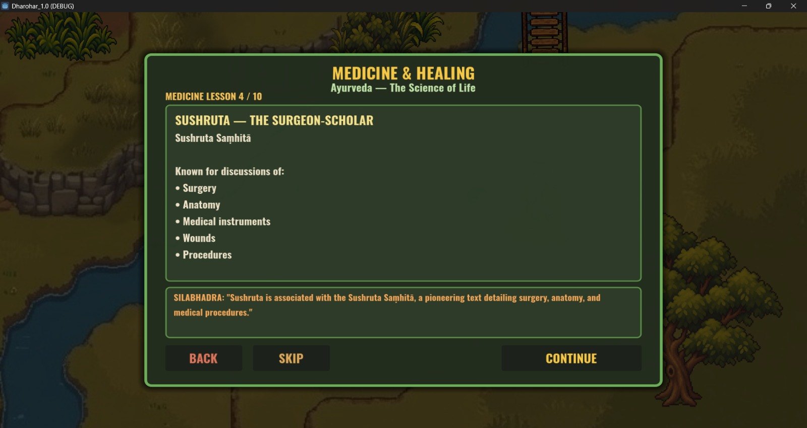
OUR BUILT MVP
Prisha_ki_sena
ENTER
EXPLORE
INTERACT
LEARN
DISCOVER
SOLVE

Slide 6
Prisha_ki_sena
FEASIBILITY AND VIABILITY
ANALYSIS
RISKS & CHALLENGES
HOW TO OVERCOME?
1. Ground AI using a verified knowledge base.
2. Use reusable assets & modular game mechanics.
3. Follow phased development for controlled scaling.
4. Conduct continuous user testing & expert validation.
1. Uses existing game engine (Godot).
2. Content can be sourced from verified historical sources.
3. Modular architecture enables easy expansion.
4. MVP can start with one era/story and scale progressively.
1. Maintaining historical accuracy.
2. High effort in creating immersive content.
3. Managing multilingual & regional diversity.
4. Balancing learning with engaging gameplay.

Slide 7
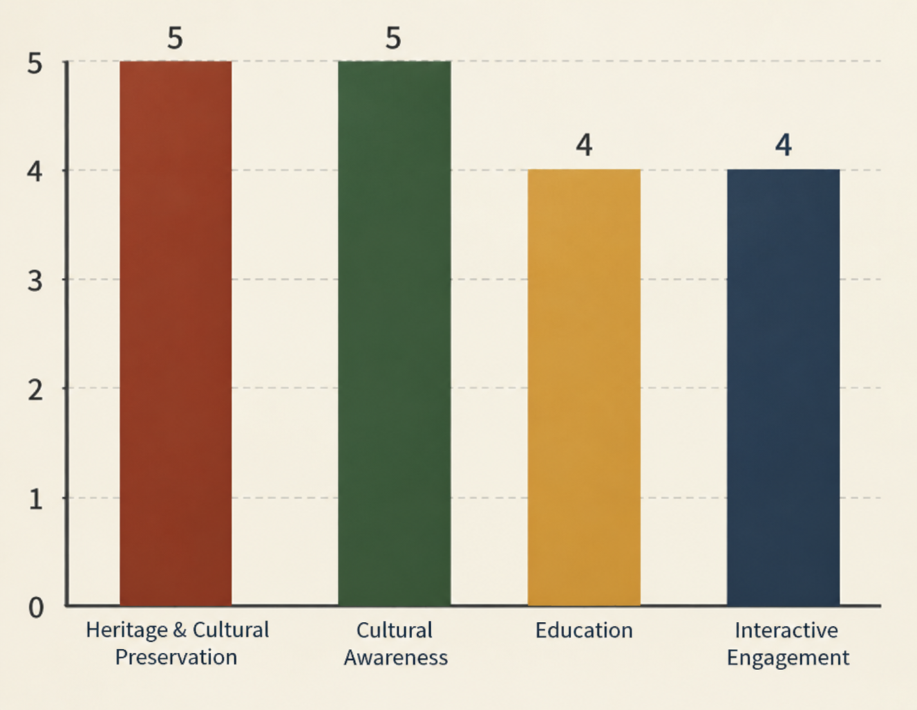





IMPACT AND BENEFITS
Prisha_ki_sena
BENEFITS
POTENTIAL IMPACT ON TARGET USERS
Multi – Industry Scope
EDUCATION
Students: Learn history through interactive gameplay.
Teachers: Use gamified content for engaging lessons.
TOURISM & HERITAGE
Virtual exploration of historical places.
Gamified heritage tours and cultural discovery.
SOCIAL IMPACT
Promotes cultural awareness and heritage preservation.
Makes history accessible to diverse audiences.
ECONOMIC IMPACT
Opportunities for local artists, creators and developers.
Supports heritage-based digital experiences and tourism.
ENVIRONMENTAL IMPACT
SDG 4 – Quality Education
SDG 11- Sustainable Cities and Communities
“EXPERIENCE HISTORY, DON’T JUST READ IT ”
94.3% of Indians aged 15–29 used the internet in 2025, indicating strong digital accessibility for Dharohar’s primary target audience.
India had 969.1 million internet subscribers by March 2025, highlighting the platform’s large potential digital reach.

Slide 8



RESEARCH AND REFERENCES
Prisha_ki_sena
NO AI PLATFORM IS USED IN RESEARCH PURPOSES
Since we claim to teach students, we provide information from credible and authorized sources.
1
WIKIPEDIA
2
UNESCO
3
BBC
ARTICLE — Nalanda
Mahavihara
ARTICLE — Archaeological
Site of Nalanda Mahavihara
at Nalanda, Bihar
ARTICLE — Nalanda: The
university that changed the
world
https://www.bbc.com/travel/article/20230222-nalanda-the-university-that-changed-the-world
https://en.wikipedia.org/wiki/Nalanda_mahavihara
https://whc.unesco.org/en/list/1502/

